Slide 1

KHATRA ADIBASI MAHAVIDYALAYA
E-Content
Department: Chemistry
Semester: VI (Honours)
Session: 2021-2022
Subject: Analytical Methods in Chemistry (CHEM/603/DSE-3)
Topic: Solvent extraction
Name of Teacher: Soumen Rakshit

Slide 2
Content
Introduction
Principle of solvent extraction
Distribution coefficient
Distribution ratio
Relation between Distribution coefficient and distribution ratio
Factors affecting solvent extraction, separation factor
Batch extraction
Countercurrent extraction
Application of solvent extraction
Numerical problems

Slide 3
Solvent extraction
Solvent extraction is also called liquid-liquid extraction (LLE) and partitioning.
Immiscible liquids are ones that cannot get mixed up together and separate into layers when shaken together. These liquids are usually water and an organic solvent.

Slide 4
Solvent extraction
Solvent extraction is the process in which a compound transfers from one solvent to another owing to the difference in solubility or distribution coefficient between these two immiscible (or slightly soluble) solvents.
It is a method of quantitative separation of compounds.
When extracting solvent is stirred with solution containing solute then solute from original solvent gets transferred into an extracting solvent.
When stirring is stopped extracting solvent form separate layer and
now it contains solute of interest.

Slide 5
Solvent extraction
Compared with other separation methods, it gives a better separation effect than chemical precipitation, and a higher degree of selectivity and faster mass transfer than the ion exchange method.
Compared advantages production
with distillation, solvent extraction such as low
has large
energy
consumption,
capacity, fast action, easy continuous
operation and ease of automation.

Slide 6
Commonly used solvents
ethyl acetate (8.1 %),
diethyl ether (6.9 %),
dichloromethane (1.3 %) and
chloroform (0.8 %) dissolved up to 10 % in water.
Water also dissolves in organic solvents:
ethyl acetate (3 %),
diethyl ether (1.4 %),
dichloromethane (0.25 %)
chloroform (0.056 %).

Slide 7
Uses of solvent extraction process
Solvent extraction is used in the processing of perfumes, vegetable oil, or biodiesel.
It is also used to recover plutonium from irradiated nuclear fuel, a process which is usually called nuclear reprocessing.
The recovered plutonium can then be re-used as nuclear fuel.

Slide 8
The properties of the solvent used for solvent extraction
The solvent should be well miscible with the liquid to be extracted.
The solvent should not be miscible with the other
components of the mixture or react with the solute.
The boiling point of the solvent should be low enough ( well below the melting point of the solute) such that it can be evaporated easily after collection.
It should have a favourable temperature coefficient.

Slide 9
Points to be considered
The solvent should be able to dissolve at least one component to a large extent than the rest of the components in the mixture.
The reaction taking place should be stable and irreversible. Reversible reactions can bring back the dissolved components in their previous form and the extraction will not be completed successfully.
The compound formed after the reaction should be easily separated from the extracted compound so that it can be reused.
The density of the compound should be different from the
required component to help the separation readily.
It should be inexpensive and cost-effective.
The solvent should not be toxic or corrosive as it can harm the
extraction instruments.
Other factors important during solvent selection are viscosity,
boiling point, flammability, etc.

Slide 10
Distribution coefficient
When a solution is placed in a separatory funnel and shaken with an
immiscible solvent, solutes often dissolve in part into both layers.
The components are said to "partition" between the two layers, or
"distribute themselves" between the two layers.
When equilibrium has established, the ratio of concentration of solute in each layer is constant for each system, and this can be represented by a value K
K is called the partition coefficient or distribution
coefficient.
K_{D}=Molarity in organic phase / Molarity in aqueous phase

Slide 11
Distribution coefficient
When a compound is placed in contact with two immiscible liquids
then the compound itself get distributed in these two liquids.
This is an equilibrium process (dissolution equilibrium) governed
by temperature of the system.
Suppose compound A is to be extracted from aqueous solution into organic liquid, then for compound A, dissolution equilibrium can be represented by the equation –
•
^{A} (aq) ^{A} (org)

Slide 12
Distribution coefficient
Under dissolution equilibrium concentration of compound A in
aqueous phase and in organic phase is definite.
K_{D}=Concentration in organic phase / Concentration in
aqueous phase

Slide 13
Amount remain extracted
From equilibrium coefficient it is clear that some quantity of a
compound will remain unextracted in aqueous phase.
In single extraction, quantitative separation of a compound from
aqueous phase into organic phase is not possible.
Thus for quantitative extraction of a compound from aqueous phase into organic phase, aqueous phase must be extracted again or number of times.

Slide 14
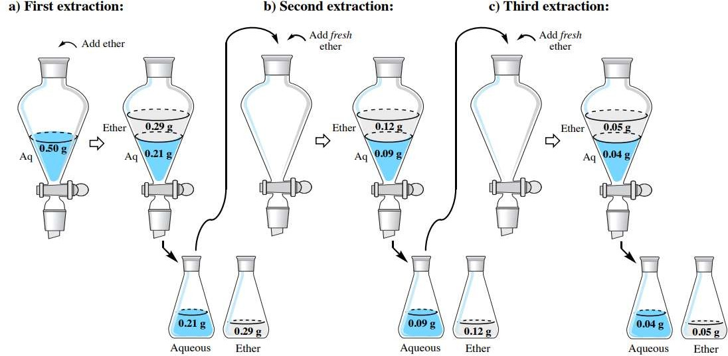

Slide 15
Equation
X_{n} = X_{a} [
^{V}aq
]
K_{D} V₀ + V_{aq}
Where,
n- no. of times solute is extracted from aqueous phase
X_{n} - quantity of solute remained in aqueous phase after n extractions
X_{a} - millimoles of solute taken in aqueous phase
K_{D} - distribution coefficient
V_{aq} – volume of aqueous phase taken for extraction
V₀ – Volume of organic phase used for extraction at a time in multiple
extraction

Slide 16
Efficiency of extraction
Percent extraction is another term used in solvent extraction to
express efficiency of extraction.
Percent extraction or efficiency of extraction (%E) can be calculated
as –
100 x m mol extracted
%E =
Total m mol in aqueous phase

Slide 17
Separation factor
If the solution to be extracted consists of two solutes A and B, and we have to separate A from B, then we will use extracting solvent which will dissolve more quantity of A and very less quantity of B.
Under this condition, effectiveness of separation is expressed in terms of separation coefficient or separation factor.
It is the ratio of distribution coefficients of two solutes A and B and denoted by -
^{K}DA
=
^{K}DB
should be very high to separate two solutes by solvent extraction, otherwise clear separation will be very difficult.

Slide 18
Distribution ratio
Many substances undergo dissociation in aqueous phase like weak
carboxylic acid such as benzoic acid, phenol, etc.
Now consider the weak acid HA which will dissociate in aqueous
phase as follows –
HA A⁻ + H⁺
The substances which undergo by accounting dissociation in aqueous layer the distribution coefficient in modified form can be defined as distribution ratio (D)
[HA ] _{org}
D =
[A-]_{aq} + [HA] _{aq}

Slide 19
Factors affecting solvent extraction
Masking agent – these are chemical species which do not allow to extract unwanted metal ion with metal ion of interest.
Modifiers – these are the substances when added into aqueous phase, they increase the solubility of solute to be extracted into organic solvent. Usually high molecular weight alcohols are used as modifiers in solvent extraction
Oxidation state – by carrying out redox reaction with suitable reagent, oxidation state of metal ion can be changed.

Slide 20
Factors affecting solvent extraction
pH – pH affects stability and charge on the metal complex. The pH at which metal ion complex is most stable and neutral is the best pH for extraction of metal ions.
Salting effect – the high concentration of salt sometimes help to extract metal ions from aqueous phase to organic phase. Salt increases ionic strength of aqueous phase and thereby increases the solubility of metal complex into organic phase.
Synergic agents – these are reagents which when added to organic phase increase the efficiency of extraction. They get associated with metal complex, make it more soluble into organic phase.

Slide 21
Solvent extraction methods of Metal ions
Chelate formation
Ion- Association method
Solvation
Synergic extraction

Slide 22
Solvent extraction techniques
Chelate formation –
Metal forms stable and neutral complexes with chelating agents.
Such chelates are usually water soluble
The chelating agents are usually bidentate or multidentate organic ligands which provide hydrophobic pocket to the metal ion.
The organic part of such ligands strongly interact with organic solvent and thereby meta- chelate become soluble into organic phase.

Slide 23
Ion association method
Metal ions form ionic complexes with certain ions. In turn these ionic complexes get associated with oppositely charged ions called as ion association complex.

Slide 24
Solvation
It is the process in which metal ion gets solvated by solvent molecule and trapped inside the solvent cage.
The solvent used for solvation is soluble in organic phase, hence metal ion gets extracted from aqueous phase into organic phase.
Carboxylic acids, ternary amines, alkyl substituted phosphoric acids. etc. can be used as extractants

Slide 25
Synergic extraction
These are the reagents which when added to organic phase increase the efficiency of extraction
They get associated with metal complex, make it more soluble into organic phase.

Slide 26
Solvent extraction techniques
Batch extraction
Continuous extraction
Countercurrent extraction

Slide 27
Batch extraction
Batch extraction, the simplest and most commonly used method, consists of extracting the solute from one immiscible layer in to other by shaking the two layers until equilibrium is attained, after which the layers are allowed to settle before sampling.
This is commonly used on the small scale in chemical laboratories.
The most commonly employed apparatus for performing a batch extraction is a separatory funnel.
The batch extractions may also be used with advantage when the distribution ratio is large

Slide 28
Countercurrent extraction
Extraction by continuous countercurrent distribution is the third general type and is used primarily for fractionation purposes.
The separation through continuous countercurrent method is achieved by virtue of the density difference between the fluids in contact.
In vertical columns, the denser phase enters at the top and flows downwards while the less dense phase enters from the bottom and flows upwards.
The choice of method to be employed will depend primarily upon the value of the distribution ratio of the solute of interest, as well as on the separation factors of the interfering materials.

Slide 29
Features essential for an extractant
To be selective for the required metal.
The ability to extract the metal at the desired acidity or pH.
Ease of formation of complex with metal of interest and high solubility of
metal organic species in the organic phase.
Ease of recovery of the metal from the organic phase.
It must be stable throughout the principle stages of solvent extraction.
It is to be prepared in laboratory in large scale.
To have acceptable rates of extraction and stripping.
Regeneration of extractant for recycling in economical large scale
processes.
There is no emulsion formation

Slide 30
Applications of solvent extraction
Determination of iron
Determination of lead in the blood
Determination of copper in the alloys such as steel
Determination of uranium
Separation and Purification of organic compounds by organic chemists
Used in drug industry by analytical chemists, bio-chemists, pharma chemists.

Slide 31
Thank You

